Slide 1

EDUCATION
This Photo by Unknown Author is licensed under CC BY-ND

Slide 2
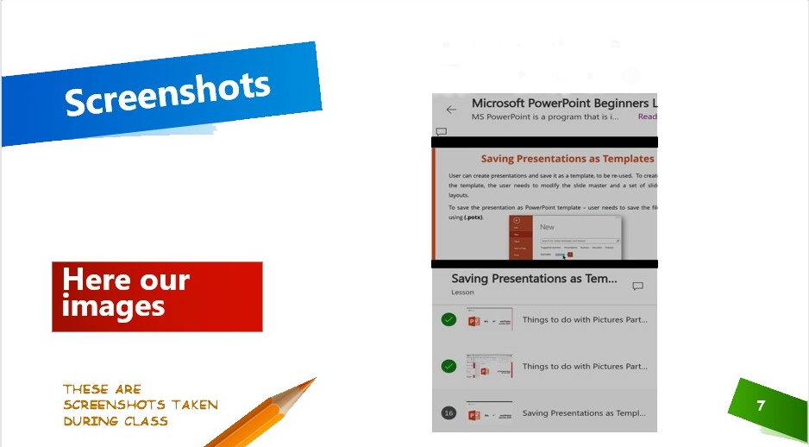

Slide 3
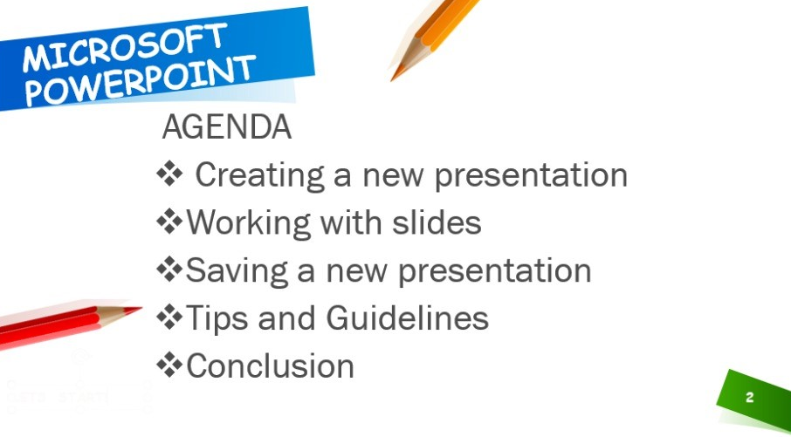

Slide 4
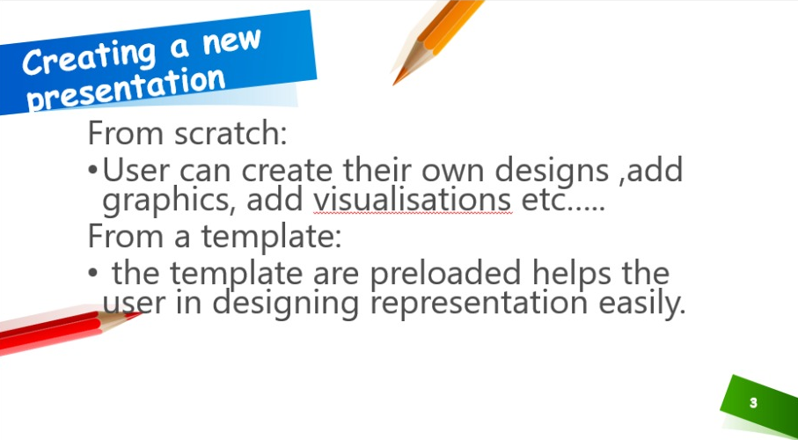

Slide 5
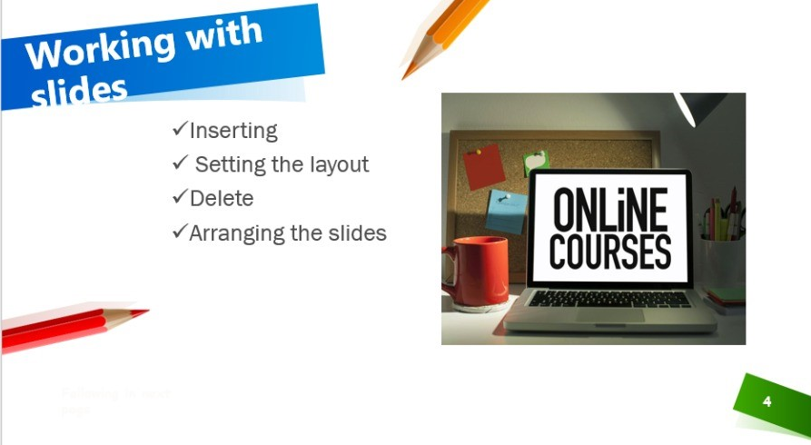
These are the basic things on working with slides.

Slide 6
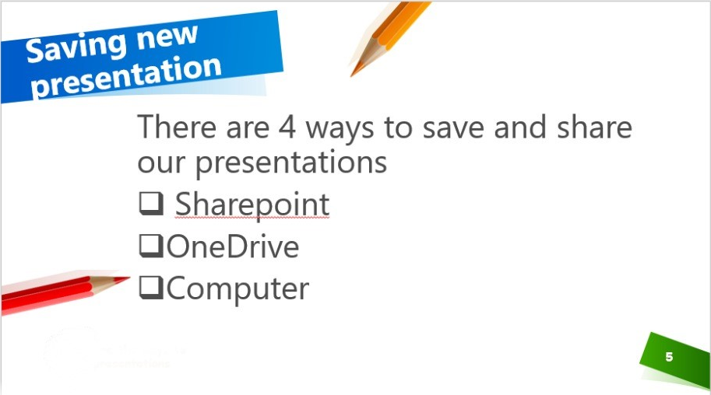

Slide 7
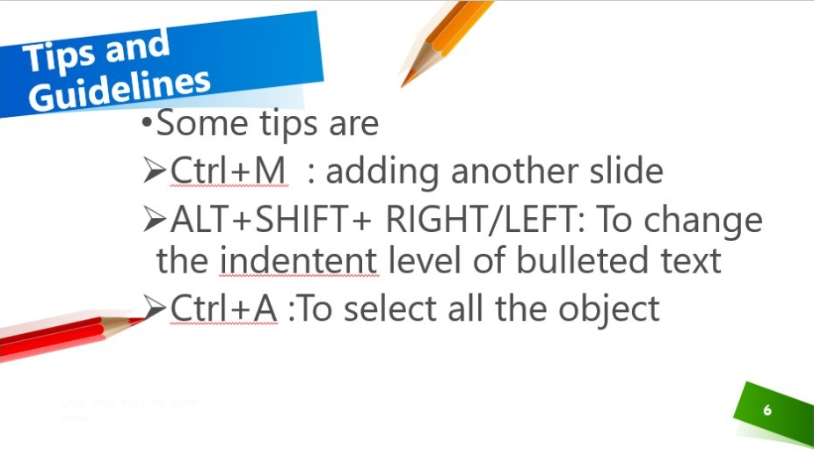

Slide 8

This Photo by Unknown Author is licensed under CC BY-NC

